Slide 1
AI Awareness for Law Librarians: Navigating the Impact and Key Platforms
Wednesday, February 7th, 12-1 pm CT
Notes:
Imagery: Imagery is inserted in the slide background. Imagery should be in widescreen format (16:9 aspect ratio) or cropped to fit. Please do not stretch imagery to fit the background.
Adding a background image. To insert a background image, go to Format >slide background. In the Format Background pane, choose Picture or texture fill. Under Insert Picture, choose FILE if you know the desktop location of the image or CLIPBOARD if the image has been copied to the clipboard.

Slide 2
Emily Florio
Director of Knowledge Research
DLA Piper LLP (US)
June Hsiao Liebert
Director of Information Services
O’Melveny & Myers LLP

Slide 3
The Basics
Generative AI basics
Current status
Use cases and approaches
Considerations
Notes:
CoCounsel, Precision AI,

Slide 4
Generative Artificial Intelligence (GAI)
Subset of AI that uses machine learning to generate new content such as text, images, music, computer code
Learns from vast amounts of data​
Understands patterns, styles, and structures​
Generates something similar but not identical
HOW: ​
Learns from vast amounts of data​
Understands patterns, styles, and structures​

Slide 5
GAI Uses Probabilistic Method
Statistical method that uses historical data to forecast future occurrences with a quantifiable level of confidence
Similar to predicting rain
review past weather data
(i.e. temperature and cloud patterns)
make an educated guess about whether it's going to rain or not
Result - Not 100% accurate, but gives chance of rain based on what usually happens in similar situations

Slide 6
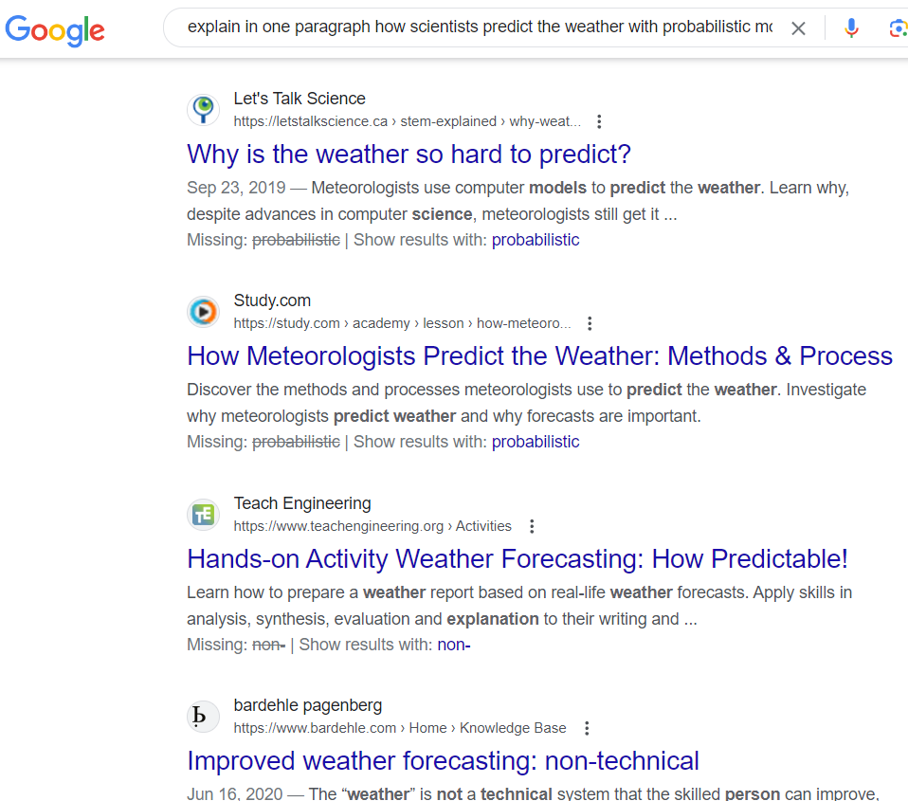
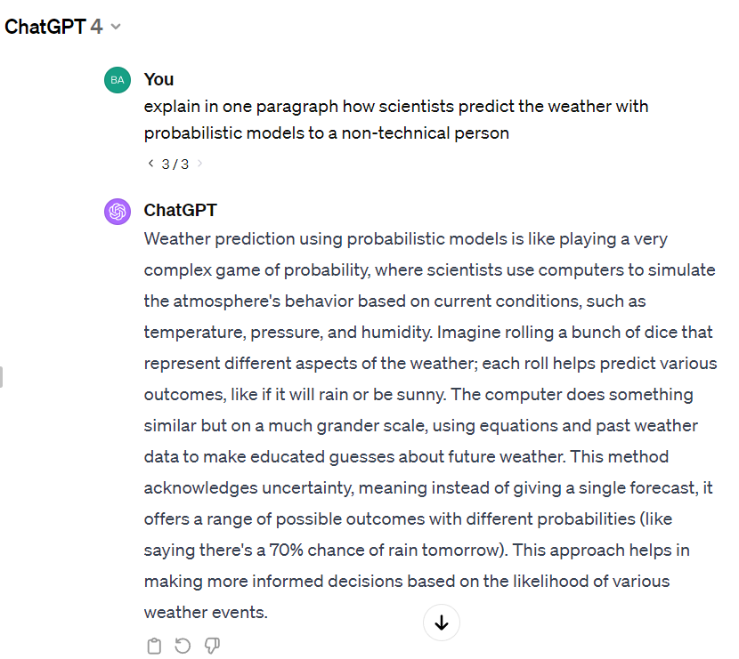
”

Slide 7
 | Traditional LR Tools | Generative AI LR Tools
Data | Curated legal databases | Wide-ranging, learning-enhanced datasets
Search | Keyword-centric | Natural language comprehension
Interaction | Keyword search and manual filtering | Conversational, intuitive queries
Search Results | Lists of documents sorted by relevance | Tailored answers, summarizations, and document drafts
Accuracy | High precision in retrieving specific documents (deterministic) | Varies depending on training data and algorithms (probabilistic)

Slide 8
Status Check
Law firms
Law schools
Courts
Notes:
-Lexis 2024 Investing in Legal Innovation Survey- 266 Managing Partners and C-suite leaders at Am Law 200 and other large law firms*, as well as legal professionals at Fortune 1000 companies between December 6, 2023 and January 9, 2024. Findings include results from 114 executives across 68 Am Law 200 firms, 102 executives across 79 other large law firms, and 50 executives across 44 Fortune 1000 companies.
-Nearly a third of the executives surveyed indicate they have a dedicated budget for generative AI in 2024 (31%), and most expect their investment in generative technologies to increase over the next 5 years (90%).
-https://www.lexisnexis.com/community/pressroom/b/news/posts/lexisnexis-collaborates-with-u-s-law-schools-to-roll-out-lexis-ai-marking-first-widespread-use-of-legal-generative-ai-solution-in-law-school-education
According to a recent LexisNexis survey of over 450 law school librarians, legal research and writing, and legal technology professors, 78% of law school faculty have plans to teach students about generative AI tools this spring. Feedback from this set of customers will be used to further optimize the solution for law school users, provide guided study tailored to the law school curriculum, and develop cutting-edge and ethical AI education tools.

Slide 9
Lexis: 2024 Investing in Legal Innovation Survey
https://www.lexisnexis.com/en-us/products/lexis-plus-ai/thought-leadership.page

Slide 10
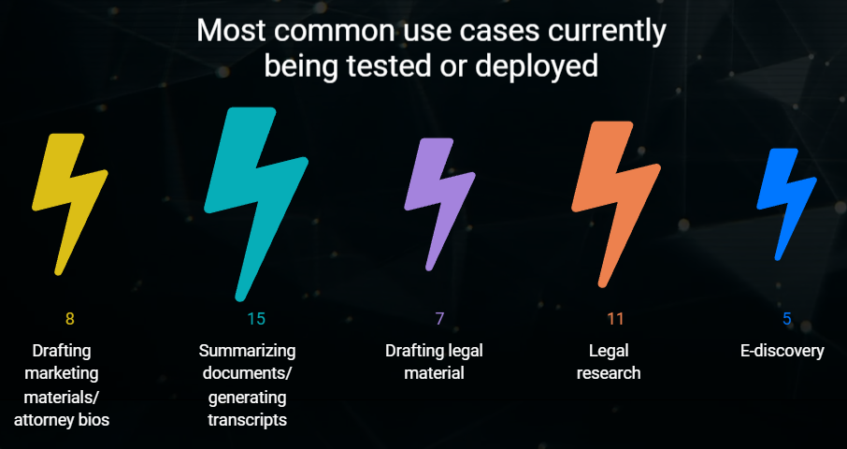
AmLaw 100 Gen AI Survey – Use Cases https://www.law.com/americanlawyer/2024/01/29/we-asked-every-am-law-100-firm-how-theyre-using-gen-ai-heres-what-we-learned

Slide 11
AmLaw 100 Gen AI Survey – Use Cases https://www.law.com/americanlawyer/2024/01/29/we-asked-every-am-law-100-firm-how-theyre-using-gen-ai-heres-what-we-learned

Slide 12
AmLaw 100 Gen AI Survey – Use Cases https://www.law.com/americanlawyer/2024/01/29/we-asked-every-am-law-100-firm-how-theyre-using-gen-ai-heres-what-we-learned

Slide 13
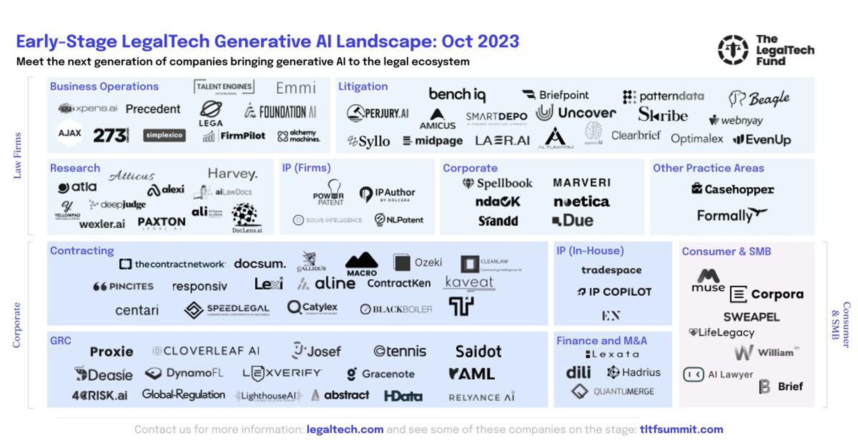

Slide 14
Current Use Cases
Summarize
Translate
Analyze
Drafting
Custom GPTs

Slide 15
Considerations
Procurement
Staffing
ROI
Awareness

Slide 16
Our Core Beliefs
Don’t ignore or be afraid of genAI
There are efficiency gains for all
genAI education is crucial

Slide 17
Reading & Listening List
Ben’s Bites & Ben’s Bites Pro
https://bensbites.beehiiv.com/
Bloomberg Law Artificial Intelligence
https://news-emails.bindg.com/v1/newsletter/0000018c-eee8-d86d-ad9d-fffb113e0001?product=BAINW&utm_source=newsletter&item=web-version&region=header
Bloomberg Law Legal Ops & Tech
https://news-emails.bindg.com/v1/newsletter/0000018c-ee50-d3fa-abbe-ff7a29d20000?product=BEDNW&utm_source=newsletter&item=web-version&region=header
The Rundown AI
https://www.therundown.ai
Brainyacts
https://thebrainyacts.beehiiv.com/
Fortune’s Eye on AI https://www.fortune.com/newsletters/eye-on-ai?tpcc=NL_Marketing
Lawyer Ex Machina
https://buttondown.email/LawyerExMachina
The Neuron
https://www.theneurondaily.com/
Hard Fork (NYT) podcast
https://www.nytimes.com/column/hard-fork

Slide 18
Questions?

